Slide 1

JOGINPALLY.B.R ENGINEERING COLLEGE DEPARTMENT OF INFORMATION TECHNOLOGY
A MAJOR PROJECT PRESENTATION ON
AI-BASED PREDICTION OF STROKE DISEASE USING ECG AND PPG BIO-SIGNALS
PRESENTED BY
P.N.S. SATYA VISHAL (19J21A1233)
J.SHYLU (19J21A1215)
G.VAMSHI SRINIVAS (19J21A1213)
UNDER THE GUIDANCE
MR.K.VENKAIAH
ASSIST.PROFESSOR

Slide 2
TABLE OF CONTENTS
ABSTRACT
INTRODUCTION
SYSTEM ANALYSIS
SYSTEM STUDY
SOFTWARE REQUIREMENTS SPECIFICATION
SYSTEM DESIGN
SYSTEM IMPLEMENTATION
SYSTEM TESTING
SCREEN SHOTS
CONCLUSION
FUTURE SCOPE
REFERENCES

Slide 3
1.ABSTRACT
Since stroke disease often causes death or serious disability, active primary prevention and early detection of prognostic symptoms are very important.
Magnetic resonance imaging or computed tomography has mostly been used to detect and predict prognostic symptoms in stroke patients.
These methodologies are difficult to diagnose early in real-time. Electrocardiogram (ECG) and photo plethysmography (PPG) measured in real-time for the elderly.

Slide 4
2.INTRODUCTION
To predict stroke disease in real-time and to produce semantic interpretation results for the elderly based on ECG and PPG-based multi-modal bio-signals.
It is a bio-signal measured by electrodes and equipment attached to the skin that can be used to analyze the electrical activity of the heart for a set period of time.
predict the prognostic symptoms of stroke disease in the elderly by collecting multi-modal bio-signals in real-time.

Slide 5
3.1 EXISTING SYSTEM
3.SYSTEM ANALYSIS
Magnetic resonance imaging or computed tomography has mostly been used to detect and predict prognostic symptoms in stroke patients.
MRI scanners use s to generate images of the organs in the body. CT scans take a fast series of X-ray pictures
This image analysis also have limitations in terms of a long test time.

Slide 6
3.1.1 DISADVANTAGES
Magnetic resonance imaging (MRI) or computed tomography (CT) are difficult to diagnose early in real-time.
This image analysis also have limitations in terms of a long test time.
Magnetic resonance imaging (MRI) or computed tomography (CT) have high cost of testing.

Slide 7
3.2 PROPOSED SYSTEM
Electrocardiogram is a bio-signal measured by electrodes attached to the skin to analyze the electrical activity of the heart for a set period of time .
ECG measures the rate and consistency of heartbeats, heart size, location and heart damage.
PPG is measured using the linear relationship between the blood volume, changes with the contraction and relaxation of the heart.

Slide 8
3.2.1 ADVANTAGES
PPG is non-invasive, low-cost method with a fast measurement time that can be used for the early prediction of cardiovascular disease.
ECG is a non-vascular test that has the advantage of being relatively easy to repeat without causing pain to patients.
ECG is a vital test for the diagnosis of heart disease.

Slide 9
4.1 FEASIBILITY STUDY
4.SYSTEM DESIGN
The feasibility of the project is analyzed in this phase and business proposal is put forth with a very general plan for the project and some cost estimates.
For feasibility analysis, some understanding of the major requirements for the system is essential.
Three key considerations involved in the feasibility analysis are

Slide 10
4.1.1 ECONOMICAL STUDY
This study is carried out to check the economic impact that the system will have on the organization.
The amount of fund that the company can pour into the research and development of the system is limited. The expenditures must be justified.
Only the customized products had to be purchased.

Slide 11
4.1.2 TECHNICAL FEASIBILITY
This study is carried out to check the technical feasibility, the technical requirements of the system.
Any system developed must not have a high demand on technical resources That lead to high demands being placed on the client.
4.1.3 SOCIAL FEASIBILITY
The aspect of study is to check the level of acceptance of the system by the user.
The user must not feel threatened by the system, instead must accept it as a necessity.

Slide 12
5.1 SOFTWARE REQUIREMENTS
5.SOFTWARE REQUIREMENTS SPECIFICATION
Operating System: Windows 11
Coding Language: Python 3.7
5.2 HARDWARE REQUIREMENTS
Processor : Intel Corei5 3.00GHz
• ROM : 256 GB
• RAM : 4 GB

Slide 13
6.1 UML DIAGRAMS
6. SYSTEM DESIGN
Unified Modeling Language(UML) is a standard a general purpose modeling language in the field of object oriented software engineering.
5.1.1 Use Case Diagram
5.1.2 Class Diagram
5.1.3 Sequence Diagram
5.1.4 Activity Diagram

Slide 14
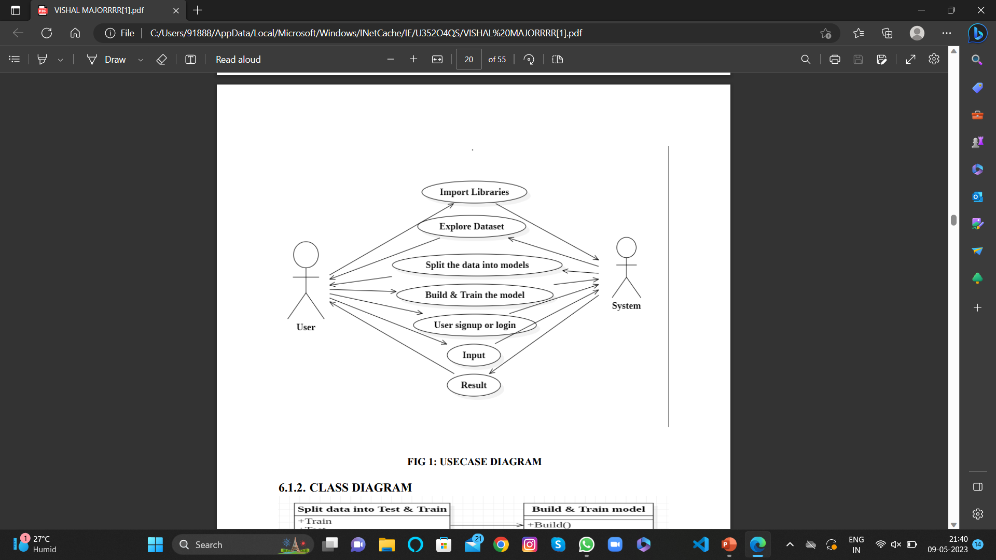
6.1.1 Use Case Diagram

Slide 15
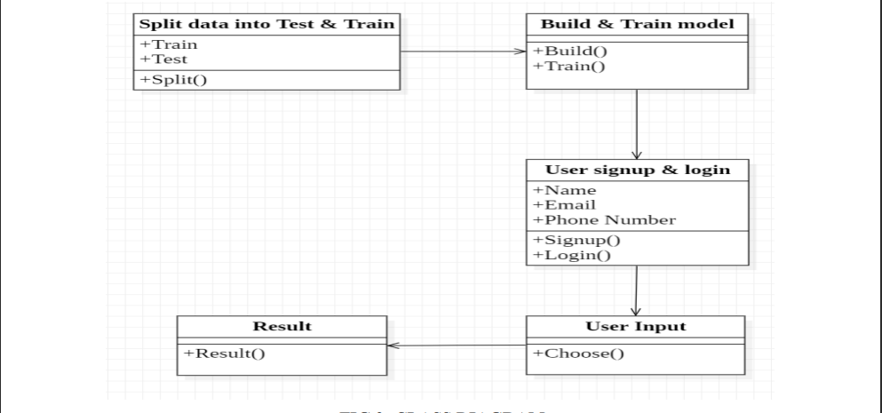
6.1.2 Class Diagram

Slide 16
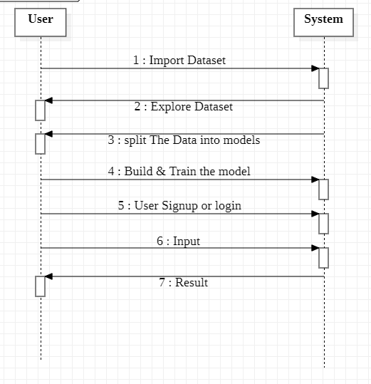
6.1.3 Sequence Diagram

Slide 17
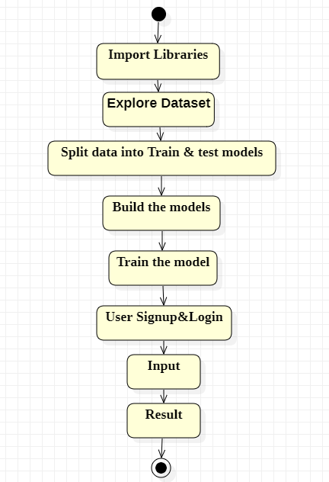
6.1.4 Activity Diagram

Slide 18
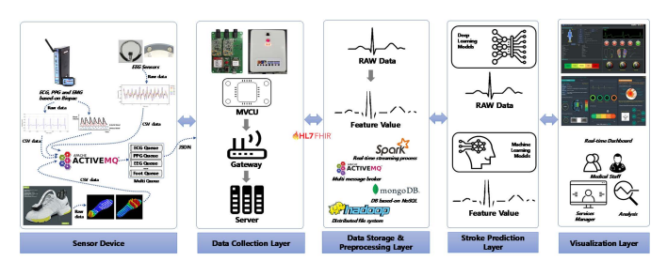
7.SYSTEM IMPLEMENTATION
7.1 SYSTEM ARCHITECTURE

Slide 19
7.2 ALGORITHMS USED
7.2.1 Convolutional Neural Network :
CNN is a type of artificial neural network, which is widely used for image/object recognition and classification.
CNN models analyse an image of a human body part, such as the Heart, and pinpoint where there might be a anomalies in X-ray images.
Its built-in convolutional layer reduces the high dimensionality of images without losing its information.

Slide 20
7.2.2 Long Short-Term Memory :
LSTMs are predominantly used to learn, process, and classify sequential data because these networks can learn long-term dependencies between time steps of data.
LSTM model is a subtype of Recurrent Neural Networks (RNN) applications include language modeling, speech recognition, and video analysis.
LSTM is used to recognize patterns in data sequences, such as those that appear in sensor data, stock prices, or natural language.

Slide 21
7.3 TECHNOLOGY USED
7.3.1 PYTHON:
Python is a high-level, interpreted, interactive and object-oriented scripting language.
Python libraries NumPy, Matplotlib, Pandas are used.
Python Libraries
NumPy:
Numpy is one of the most commonly used packages for scientific computing in Python. It provides a multidimensional array object, as well as variations such as matrices, which can be used for various math operations.

Slide 22
Pandas:
Pandas is an open source Python package that is most widely used for data analysis and machine learning tasks .It aims to be the fundamental high-level building block for doing practical, real-world data analysis in Python.
Matplotlib:
Matplotlib is a Python 2D plotting library and it is a cross-platform, data visualization and graphical plotting library for Python . Matplotlib tries to make easy things easy and hard things possible.

Slide 23
8. SYSTEM TESTING
Types of testing-
8.1.1 UNIT TESTING:
Each module is considered independently . It focuses on each unit of software as implemented in the source code.
Functionality of the entire module.
Validations for user input.
Checking of the coding standards to be maintained during code.

Slide 24
8.1.2 INTEGRATION TESTING:
The phase in software testing in which individual software modules are combined and tested as a group.
Technique for constructing tests to uncover errors associated with the interface.
All modules are combined in this testing step.
Then the entire program was tested as a whole.

Slide 25
8.2 TEST CASES & RESULTS
S. NO | TEST CASES | TEST CASE DESCRIPTION | EXPECTED OUTPUT | OBTAINED OUTPUT | TEST RESULT | REMARKS
01 | User Signup | User has to enter Required data to register | Successfully Registered | Registration Successful | Pass
02 | User Signup | If User enter wrong Email format | Registration failed | Registration failed | Pass | You Need to Enter Correct Email Format
03 | User Login | If Invalid user try to Login | Invalid details | Invalid details | Pass | You need to Register first (Or) Enter valid details
04 | User Login | User enter valid username & password | Login Successfully | Login Successfully | Pass
05 | Prediction Of stroke disease | It is based on ECG & PPG | Stroke disease occur | Stroke disease occur | Pass
06 | Prediction Of stroke disease | It is based on ECG & PPG | Stroke disease not found | Stroke disease not found | Pass

Slide 26
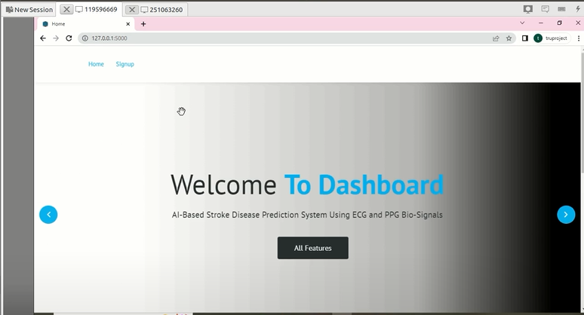
9. SCREENSHOTS

Slide 27
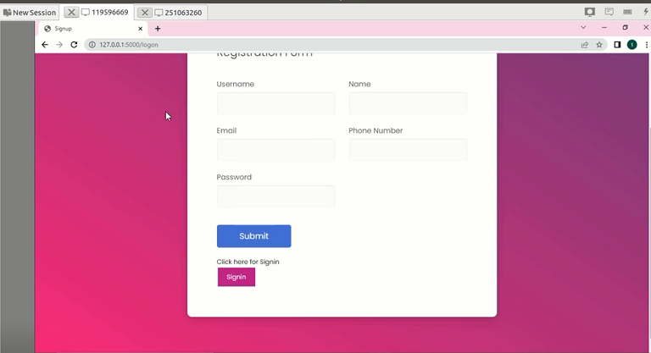

Slide 28
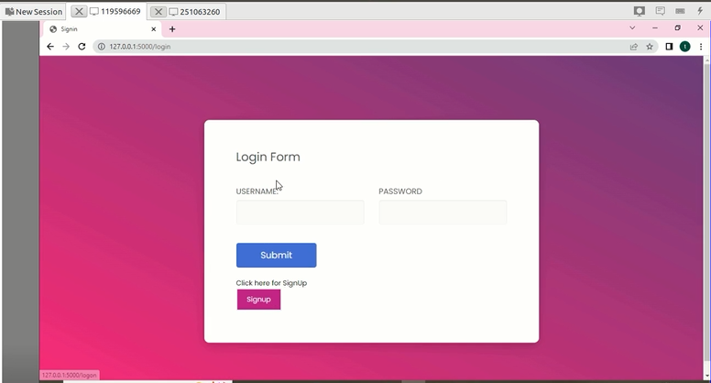

Slide 29
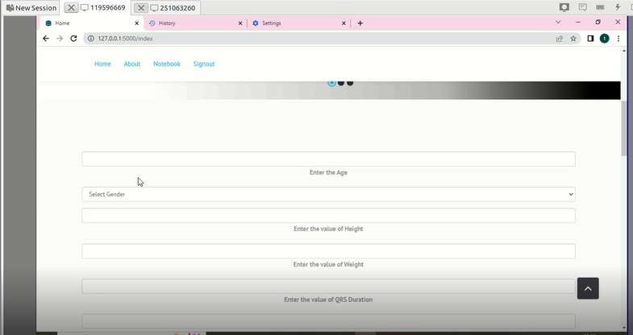

Slide 30
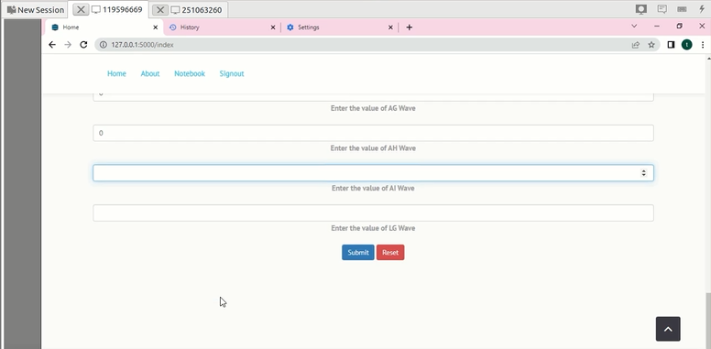

Slide 31
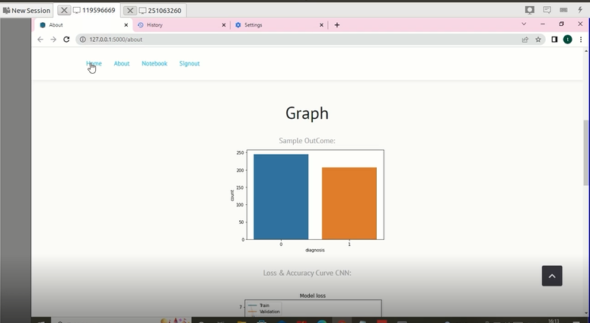

Slide 32
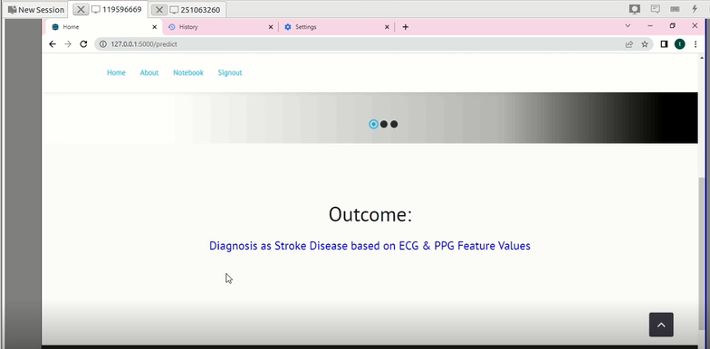

Slide 33
10. CONCLUSION
The proposed system collects multiple bio-signals of ECG and PPG can immediately detect and predict symptoms of stroke disease in the elderly.
It was experimentally verified that stroke patients can be predicted by more than 90% based solely on ECG and PPG collected while walking.
To summarize the experimental and verification results, we confirmed that we can accurately predict 91.56%

Slide 34
11. FUTURE SCOPE
In future studies, it conduct in-depth analysis and predictive experiments of stroke disease by analyzing various bio-signals such as EEG, EMG, foot pressure, and motion, as well as electronic medical records (EMRs) and MRI image information.
It can accurately predict the prognostic symptoms and onset of stroke by measuring ECG and PPG at low cost which can be worn with little inconvenience during daily life.

Slide 35
12. REFERENCE
S. De Raedt, A. De Vos, and J. De Keyser, ‘‘Autonomic dysfunction in acute ischemic stroke: An underexplored therapeutic area?’’ J. Neurol. Sci., vol. 348, nos. 1–2, pp. 24–34, Jan. 2015.
C. P. Warlow, ‘‘Epidemiology of stroke,’’ Lancet, vol. 352, pp. 1–4, Oct. 1998.
K.-D. Seo, M. J. Kang, G. S. Kim, J. H. Lee, S. H. Suh, and K.-Y. Lee, ‘‘National trends in clinical outcomes of endovascular therapy for ischemic stroke in South Korea between 2008 and 2016,’’ J. Stroke, vol. 22, no. 3, pp. 412–415, Sep. 2020.

Slide 36
THANK YOU

